Slide 1
Capstone Presentation
By
Rajesh Mambulli

Slide 2
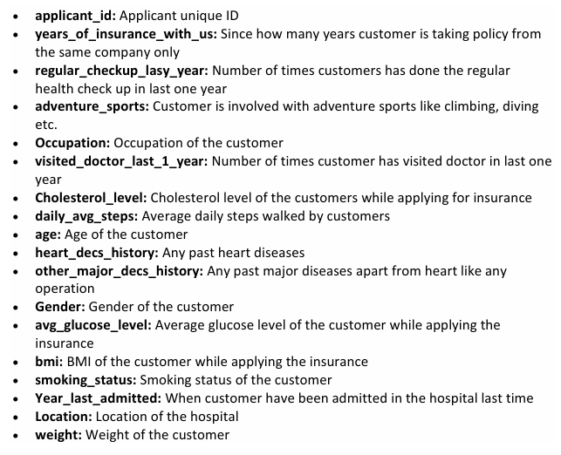
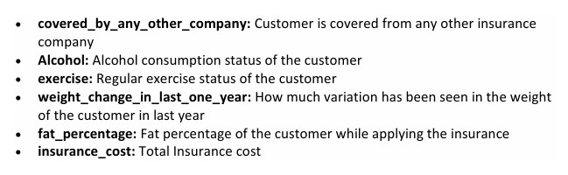
Business Problem Understanding
Business Problem:
We all know that Health care is very important domain in the market. It is directly linked with the life of the individual; hence we have to be always be proactive in this particular domain. Money plays a major role in this domain, because sometime treatment becomes super costly and if any individual is not covered under the insurance, then it will become a pretty tough financial situation for that individual. The companies in the medical insurance also want to reduce their risk by optimizing the insurance cost, because we all know a healthy body is in the hand of the individual only. If individual eat healthy and do proper exercise the chance of getting ill is drastically reduced.
Goal & Objective:
The objective of this exercise is to build a model, using data that provide the optimum insurance cost for an individual. You have to use the health and habit related parameters for the estimated cost of insurance.
Target Variable: Insurance Cost
Data Dictionary:

Slide 3
Business Problem Understanding (contd..)
Exploratory Data Analysis :
Univariate Analysis – Key Insights
Years with Insurance – Peak at 3 years (2,990 customers).
Regular Checkups – Most customers have 0–2 checkups/year.
Adventure Sports – Majority not involved.
Occupation – Mainly Business and Students.
Doctor Visits – Commonly 2–4 visits/year.
Cholesterol Level – Mostly in 125–175 safe range.
Daily Steps – Peak at 4,000–6,000 steps/day; few highly active users.
Age – Median around 45 years, evenly spread across 20–70.
Heart & Major Disease History – Majority no prior records.
Gender – Male-dominated dataset.
Glucose Level – Skewed right; many above normal.
BMI – Most between 28–33; right-skewed.
Smoking – Majority “Never Smoked”; some unknown status.
Location – Mostly Bangalore.
Weight – Peak at 70–75 kg, slight right skew.
Other Coverage – Most no alternate coverage.
Alcohol – Majority occasional drinkers.
Exercise – Majority Moderate.
Fat % – Mode around 35%, right-skewed.
Insurance Cost – Highest density in 20K–30K, right-skewed tail to ₹70K.
Bivariate Analysis – Key Insights
Strong Positive Correlation:
Fat %, Avg Glucose Level, BMI, Heart Disease History, Other Major Disease History, Weight Change (Last Year).
Moderate/Low Correlation:
Age (mild positive), Cholesterol (low), Smoking Status (low), Alcohol (modest).
Slight Negative Correlation:
Exercise, Daily Steps.
No Correlation:
Years with Insurance, Other Insurance Coverage.
Key Patterns with Mean Insurance Cost:
More Checkups → Higher cost (max at 5 checkups/year).
Adventure Sports → Higher cost (~32K vs 27K).
Occupation – Business & Students slightly higher than Salaried.
Cholesterol – Highest cost in 200–225 group.
Steps – Low activity and moderate activity cost similar; high activity slightly lower.
Heart/Major Disease History – Clearly higher costs.
Gender – Costs nearly equal despite male majority.
BMI – Highest cost in healthy BMI (<25), moderate dip in overweight, slight rise in obese.
Smoking – “Unknown” status highest cost.
Alcohol – Daily consumer's highest cost.
Exercise – Moderate exercise group has highest average cost.
Fat % – <25% fat surprisingly highest cost; >35% lowest (possible underutilization).

Slide 4
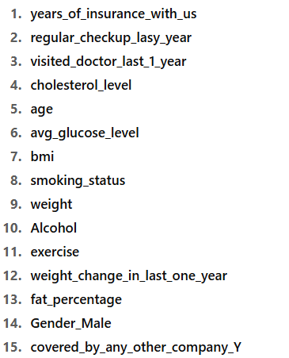
Business Problem Understanding (contd..)
Exploratory Data Analysis (contd..):
Picked Top 15 Features from Model:
Cluster Analysis – Key Findings
Cluster 0 – Health-Conscious but High-Cost
Traits: Moderate exercise, frequent doctor visits, low smoking/alcohol, mostly male, limited external coverage.
Interpretation: Proactive healthcare users; higher utilization drives up costs.
Cluster 1 – Low Engagement, Silent Risk
Traits: Few/no checkups, low doctor visits, sedentary, higher alcohol consumption, low external coverage.
Interpretation: Avoid healthcare until late-stage; risk of delayed chronic condition detection.
Cluster 2 – Lean, Fitness-Forward Males
Traits: Extreme or no exercise, mostly male, lower healthcare engagement, mixed alcohol habits, more external coverage.
Interpretation: Younger, leaner, underutilizing insurance due to partial coverage.
Cluster 3 – Data-Ambiguous but Potentially High-Risk
Traits: Many unknown smoking statuses, high alcohol prevalence, neutral exercise, gender-balanced, external coverage present.
Interpretation: Missing/ambiguous data hides risks; cost-volatile and hard to profile.

Slide 5
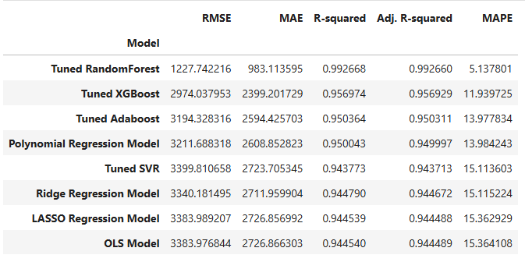
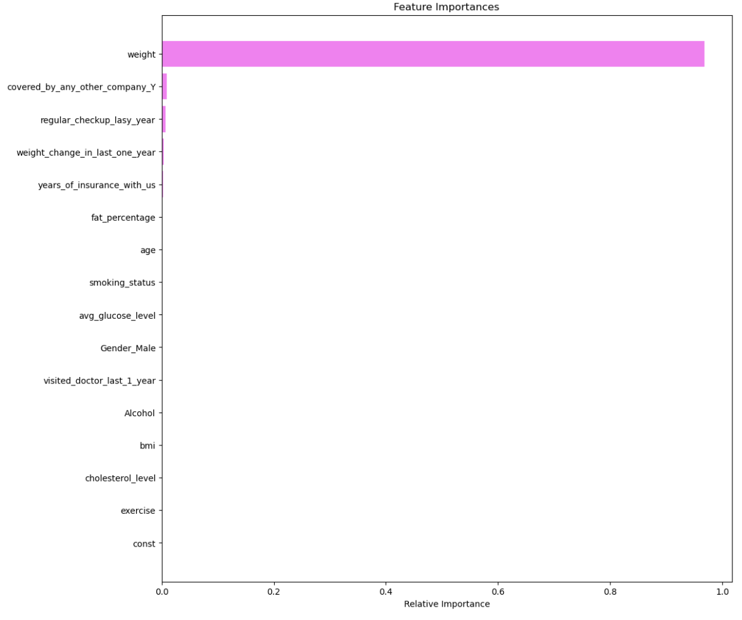
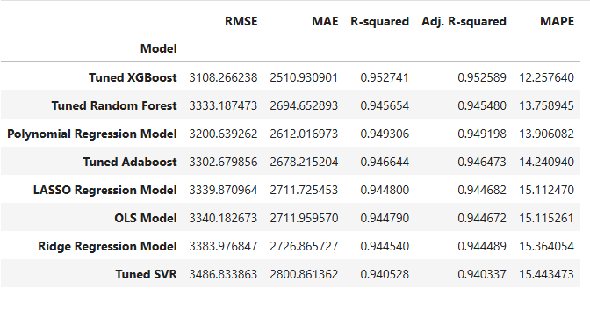
Modelling Approach Used & Why
Model Performances on Training Data
Feature Importance of Tuned XG Boost Model
Model Performances on Testing Data
Weight – ~95% importance → The single most influential factor; higher weight strongly correlates with higher insurance cost.
Coverage by Another Insurance Company – ~1.5% importance → Indicates partial risk sharing; affects pricing strategy slightly.
Regular Health Checkups – ~1.5% importance → Frequent checkups may flag chronic conditions or proactive care needs.
Other Features (combined) – ~2% importance → Includes BMI, avg_glucose_level, fat_percentage, age, smoking_status, cholesterol_level, exercise, weight change, gender, tenure, alcohol use; mostly minor impact compared to top 3.

Slide 6
Insights from Analysis
1. Weight (~95% importance)
Direction of Impact: Positive.
Interpretation: Higher body weight generally reflects higher BMI and fat %, both linked to increased cardio-metabolic risk (e.g., diabetes, heart disease).
Business Impact: Individuals with higher weight are more likely to incur higher medical expenses, leading to higher insurance costs.
2. Coverage by Another Insurance Company (~1.5% importance)
Direction of Impact: Mixed.
Interpretation: Having additional coverage could mean:
Lower actual utilization of this policy (cost dilution), OR
Higher baseline risk prompting individuals to seek multiple coverages.
Business Impact: While the direct correlation with cost is minor, this variable signals customer risk perception and can influence premium structuring or cross-sell opportunities.
3. Regular Health Checkups (~1.5% importance)
Direction of Impact: Positive.
Interpretation:
Higher checkup frequency often means active health monitoring — but in insurance pricing, it may also flag existing chronic conditions requiring continuous management.
Preventive care can lower long-term risks, but short-term insurance cost may be higher due to increased utilization.
Business Impact:
Can serve as a leading indicator for proactive care segments.
May justify wellness incentives or discounts to encourage preventive habits while managing claims.

Slide 7
Insights from Analysis (contd..)
4. Other Features (Combined ~2%)
BMI, Avg Glucose Level, Fat %, Age, Smoking, Cholesterol, Exercise, Alcohol, Weight Change, Gender, Tenure
General Impact:
These contribute marginally in isolation but can have stronger predictive power when interacting with top features (e.g., BMI + Age, Glucose + Weight).
Provide context to refine customer health profiles, underwriting, and segmentation.

Slide 8
Recommendations
Weight Management Programs (Top Predictor – 95% importance)
Launch targeted wellness programs focusing on weight reduction and healthy BMI maintenance.
Offer premium discounts or cashback incentives for customers achieving set weight or fitness targets.
Partner with gyms, nutritionists, and wellness apps for corporate health packages.
Engagement for Low-Touch Segments (Cluster 1 – Silent Risk)
Create outreach campaigns for customers with few/no checkups and low activity levels.
Offer free annual screenings or preventive care vouchers to encourage early diagnosis.
Use mobile nudges and gamified health challenges to boost participation.
Customized Plans for Dual-Coverage Holders
For customers with coverage from another insurance company, design add-on or supplementary plans to capture additional engagement.
Position these as “gap coverage” for risks not fully covered by their other policies.
Incentivizing Preventive Healthcare
While frequent checkups indicate higher short-term costs, they can lower long-term claim severity.
Introduce wellness rewards for preventive screenings, chronic condition management programs, and health coaching.
Address Data Ambiguity (Cluster 3)
High rates of unknown smoking status and other missing lifestyle details can hide risk.
Improve data capture at onboarding and through periodic surveys.
Consider underwriting review or predictive risk scoring for incomplete profiles.
Promote Active Lifestyles
Leverage step-count and exercise-level data to reward customers achieving activity milestones.
Partner with wearable tech companies to link activity tracking with premium discounts.

